Slide 1
Discrete Mathematics BCSC 0010
Module 2
Propositional Logic
(Logical Connectives and Truth Tables)

Slide 2
Conditional or Implication
Let p and q be propositions.
The conditional statement p → q is the proposition "if p, then q."
The conditional statement p → q is false when p is true and q is false, and true otherwise.
In the conditional statement p → q, p is called the hypothesis (or antecedent or premise) and q is called the conclusion (or consequence).

Slide 3
Variety of terminology is used to express p → q
"if p, then q"
"if p, q"
"q if p"
"q when p"
"q unless ~p"
"p implies q"
"p only if q"
"q whenever p"
"q follows from p"

Slide 4
Example
Let p be the statement "Maria learns discrete mathematics" and q the statement "Maria will find a good job." Express the statement p → q as a statement in English.
“If Maria learns discrete mathematics, then she will find a good job.”
or
“Maria will find a good job when she learns discrete mathematics.”

Slide 5
CONVERSE, CONTRAPOSITIVE, AND INVERSE
We can form some new conditional statements starting with a conditional statement p → q.
The converse of p → q is the proposition q → p.
The contrapositive of p → q is the proposition ~ q → ~ p.
The inverse of p → q is the proposition ~ p → ~ q.

Slide 6
The contrapositive always has the same truth value as p →q .
When two compound propositions always have the same truth value we call them equivalent, so conditional statement and its contrapositive are equivalent.
The converse and the inverse of a conditional statement are also equivalent

Slide 7
What are the contrapositive, the converse, and the inverse of the conditional statement "The home team wins whenever it is raining."?
Solution:
Because “q whenever p” is one of the ways to express the conditional statement p → q, the original statement can be rewritten as
“If it is raining, then the home team wins.”
Consequently,
contrapositive : “If the home team does not win, then it is not raining.”
converse: “If the home team wins, then it is raining.”
Inverse: “If it is not raining, then the home team does not win.”

Slide 8
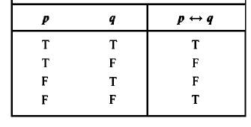
Biconditional or Equivalence
We now introduce another way to combine propositions that expresses that two propositions have the same truth value.
Let p and q be propositions. The biconditional statement p ↔ q is the proposition "p if and only if q."
The biconditional statement p ↔ q is true when p and q have the same truth values, and is false otherwise. Biconditional statements are also called bi-implications.

Slide 9
Biconditional or Equivalence
There are some other common ways to express p ↔ q
"p is necessary and sufficient for q"
"if p then q, and conversely"
"p iff q"
p ↔ q has exactly the same truth value as (p → q) ∧ (q → p).

Slide 10
Example
Let p be the statement “You can take the flight”
and let q be the statement “You buy a ticket.”
Then p ↔ q is the statement :
"You can take the flight if and only if you buy a ticket."

Slide 11
Precedence of connectives
For example, ￢p ∧ q means (￢p) ∧ q
not ￢(p ∧ q)

Slide 12
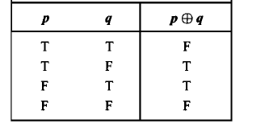
Exclusive OR (XOR)
Let p and q be propositions.
The exclusive or of p and q, denoted by p⊕q is the proposition that is true when exactly one of p and q is true and is false otherwise.

Slide 13
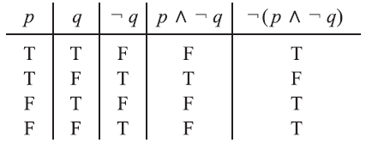
Truth Tables of Compound Propositions
Construct a truth table for the proposition ￢(p∧￢q)

Slide 14
Construct a truth table for the proposition (p v ~q) → (p ∧ q)

Slide 15
Next Topic
How to Translate English Sentences into expressions

